Slide 1


NU Student Companion
Team Members
1.Kshama Aditi Lethakula - 002784433
2.Kodand Ram Movva - 002701533
3.Sai Sree Pothireddy gari - 002744283
4.Nency Panchani - 002746779

Slide 2
Project Description
Student Companion is an all-in-one solution for students to track their daily activities, including food intake, exercise, sleep, and study time. This website helps users evaluate their progress towards their goals and optimize their overall health and wellbeing. It has a responsive UI built using ReactJS and a scalable NodeJS server with ExpressJS middleware to handle requests. Data is stored in MongoDB, and the app uses multiple open-source APIs for enhanced functionality.

Slide 3







Tech Stack
Frontend
Backend

Slide 4
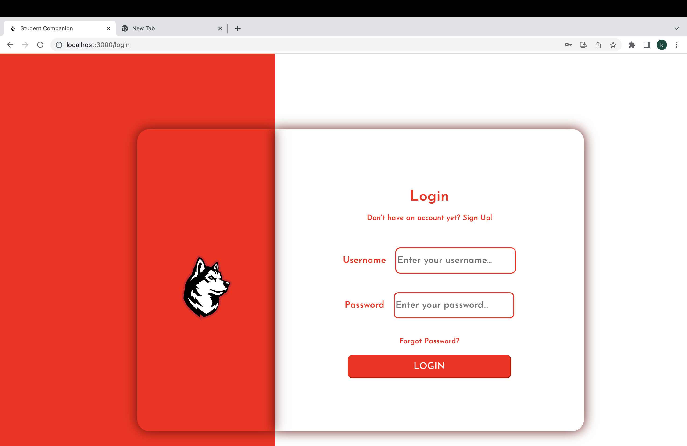
Login Page:

Slide 5
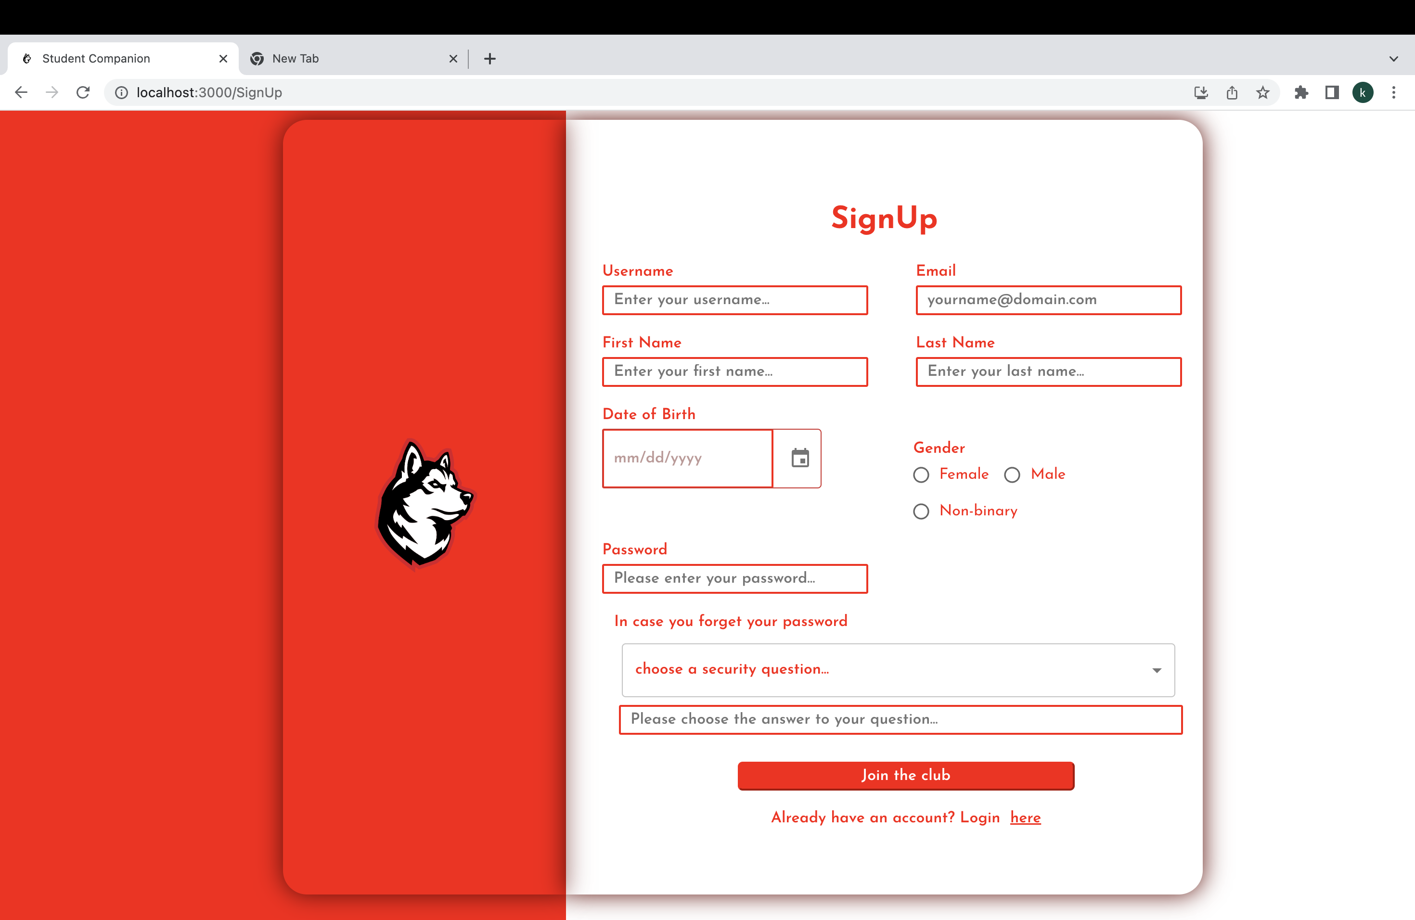
Sign Up Page:

Slide 6
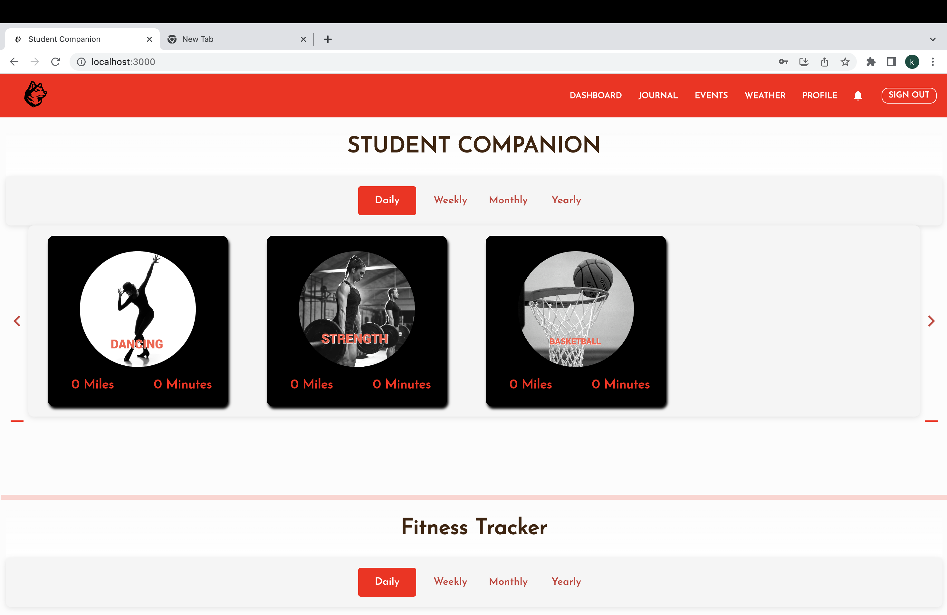
Dashboard:

Slide 7
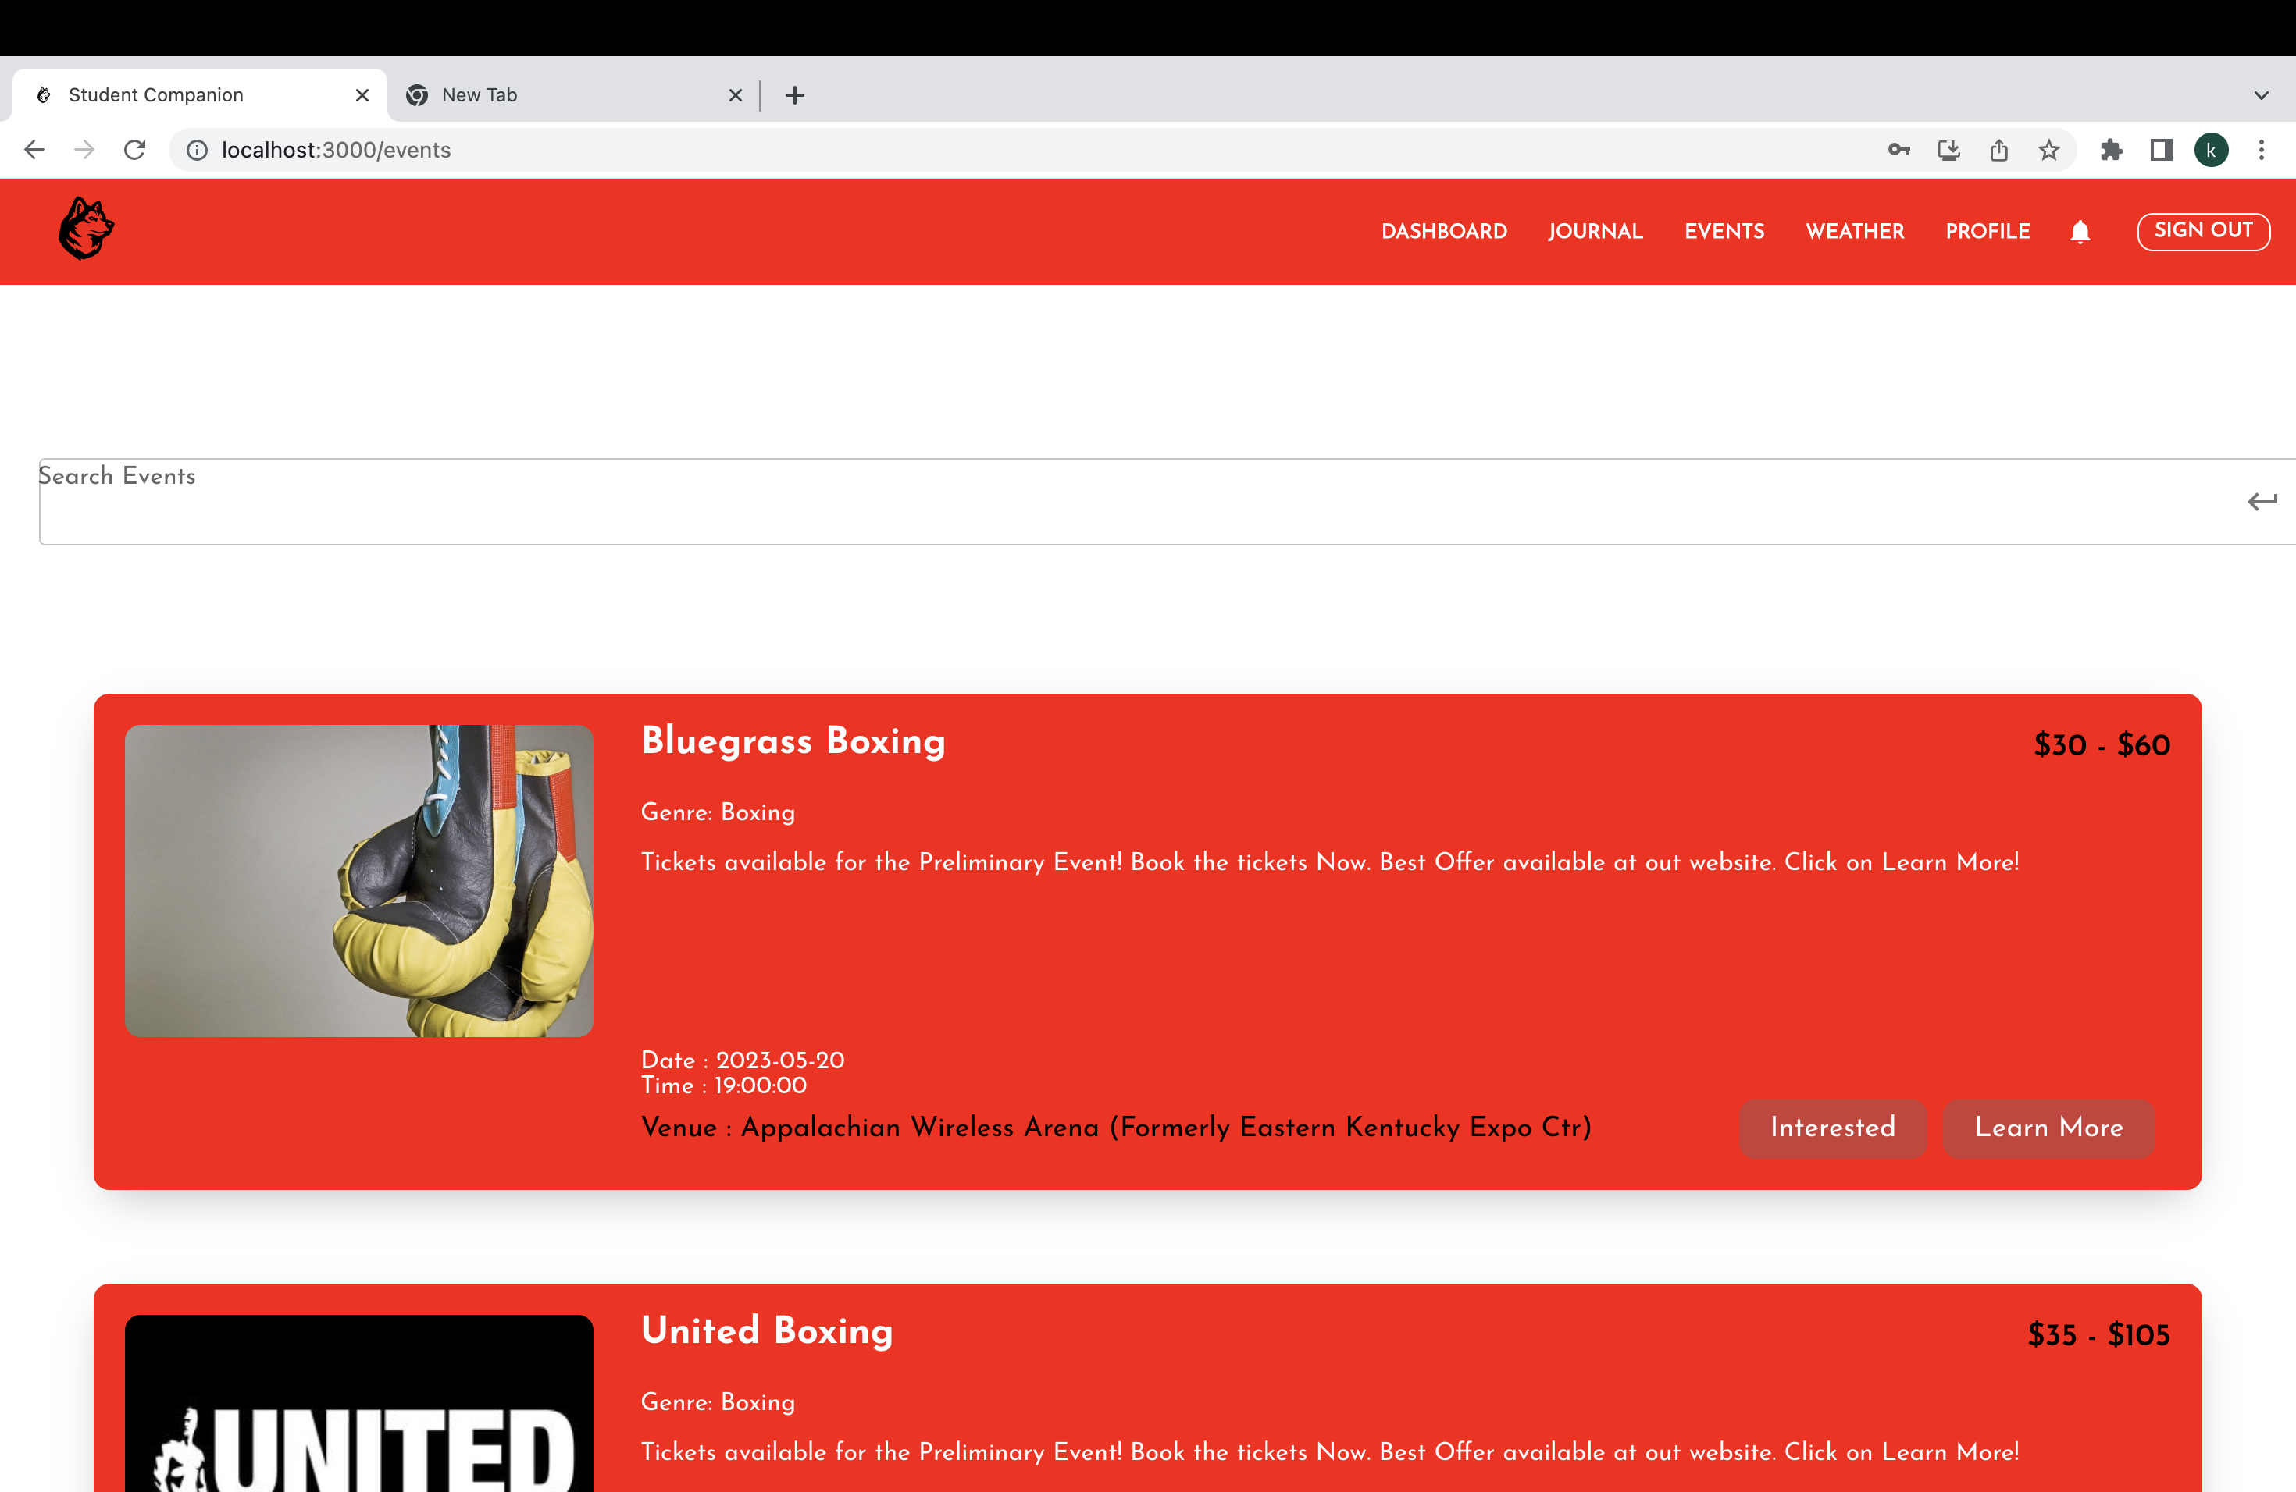
Events:

Slide 8
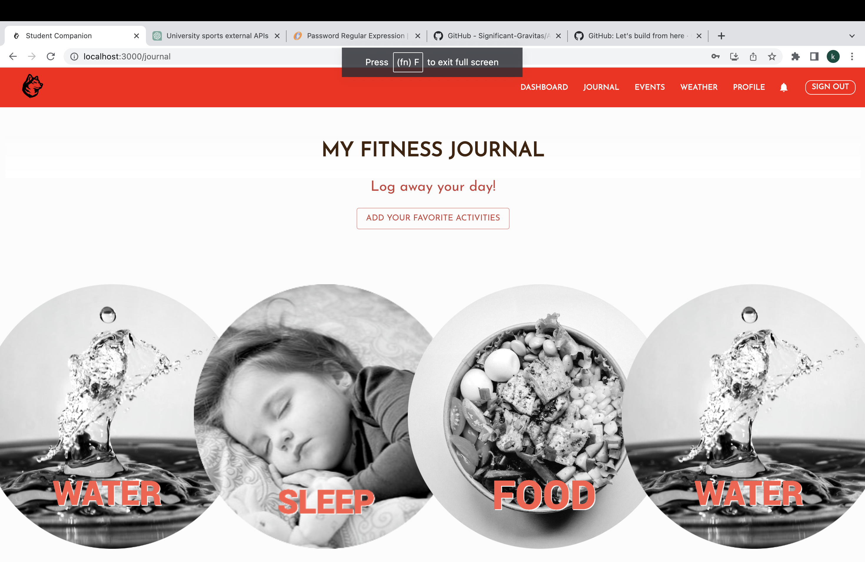
journal:

Slide 9
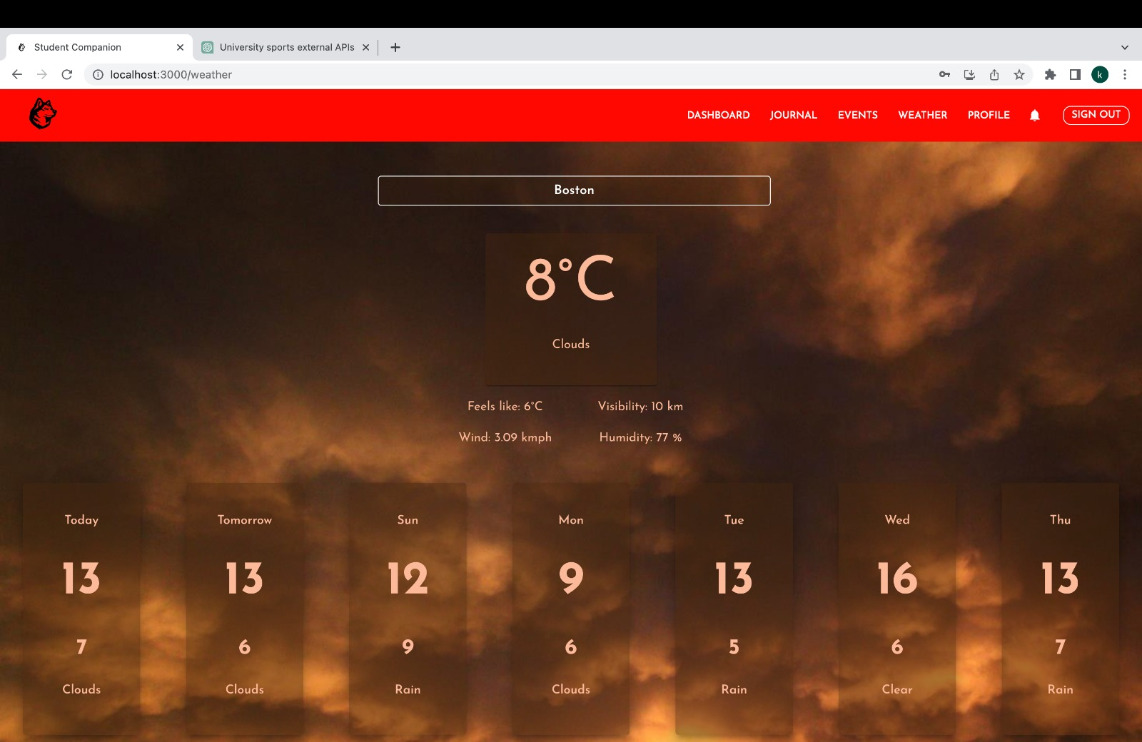
Weather Page:

Slide 10
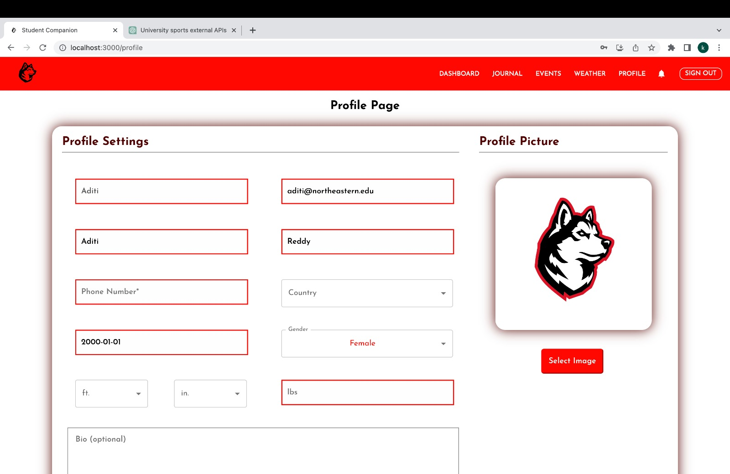
Profile:

Slide 11
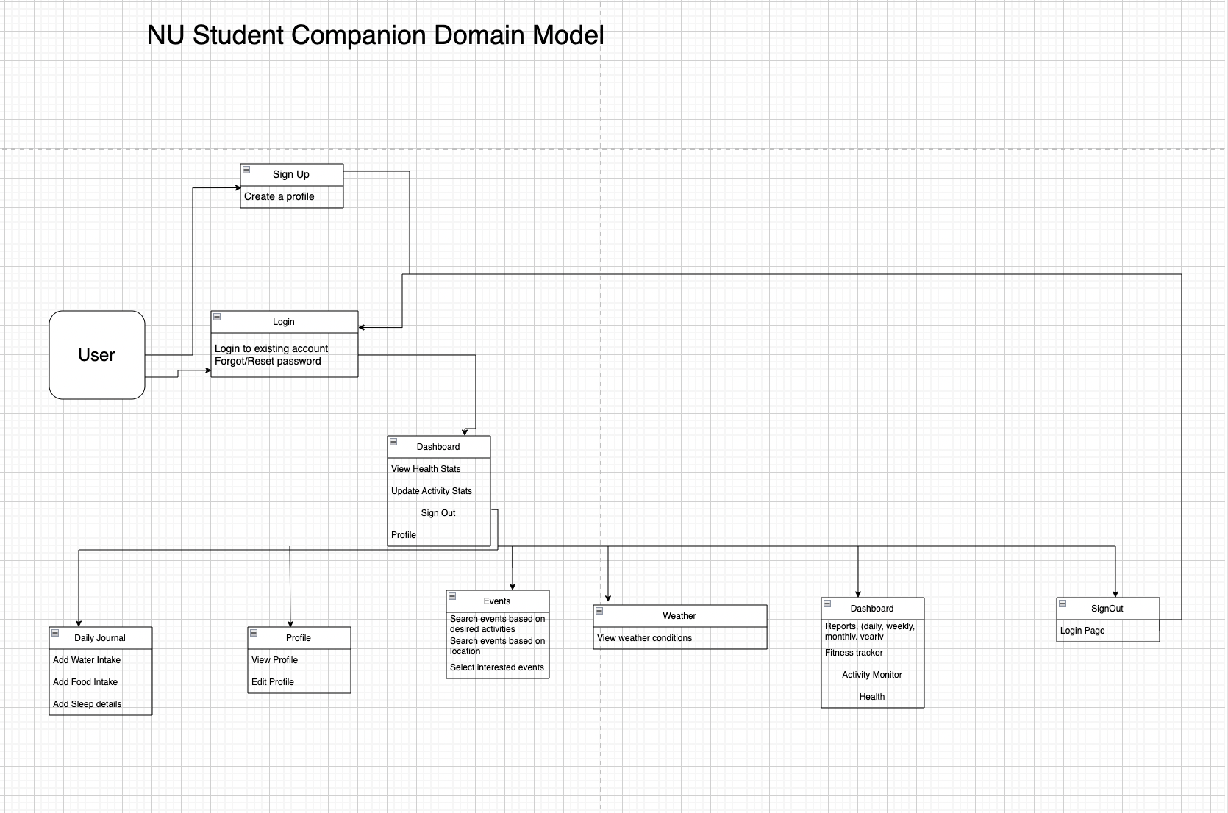
Domain Model:

Slide 12
Thankyou

